Slide 1
Automated Shrimp Farming & Monitoring System
Presented By
MD. Nayeem
2017-2-60-028
Yeasir Arafat Shahed
2017-2-60-089
Sayed Atique Newaz
2017-2-60-067
Presented To
Dr. Md. Nawab Yousuf Ali
Professor
Department of Computer Science & Engineering
East West University

Slide 2

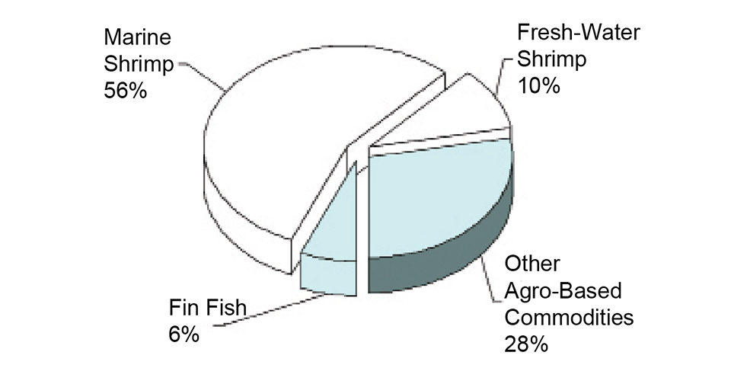
Shrimp Market
The average people eat about 4 pounds of the shrimp every year.
Shrimp-based industries in Bangladesh directly employ almost 700,000 people
Bangladesh's exports of shrimp amounted to $507.3 million.
95 percent of frozen food exports, which amounted to $534 million, represented shrimp output.

Slide 3
Motivations
In general Bangladesh Shrimp Farmers doesn’t have proper devices to cultivate shrimp in numerous number cause during the cultivation process many of the shrimps die for lack of proper care and proper knowledges.
We here want to make something for our farmers so that using it they can have better results.

Slide 4


System Requirements
Arduino Uno
Turbidity Sensor
Ultrasonic sensor
2 DC Motors
LED Display
Light Dependent Resistor (LDR)
Buzzer
Potentiometer
Variable Resistor
LED Light

Slide 5
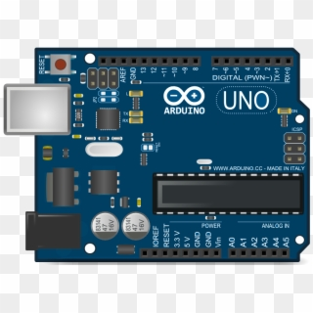
Arduino Uno
We used this Arduino uno because it contains everything needed to support the microcontroller; simply connect it to a computer with a USB cable or power it with a AC-to-DC adapter or battery to get started.

Slide 6
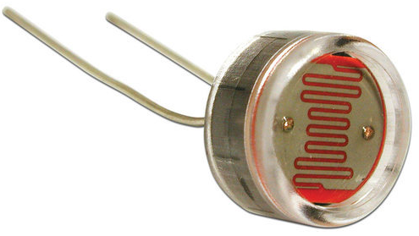
Light Dependent Resistor (LDR)
We use LDR to measure the light luminosity, if the light source is dim then an artificial light will be the source light of the shrimp farm.

Slide 7
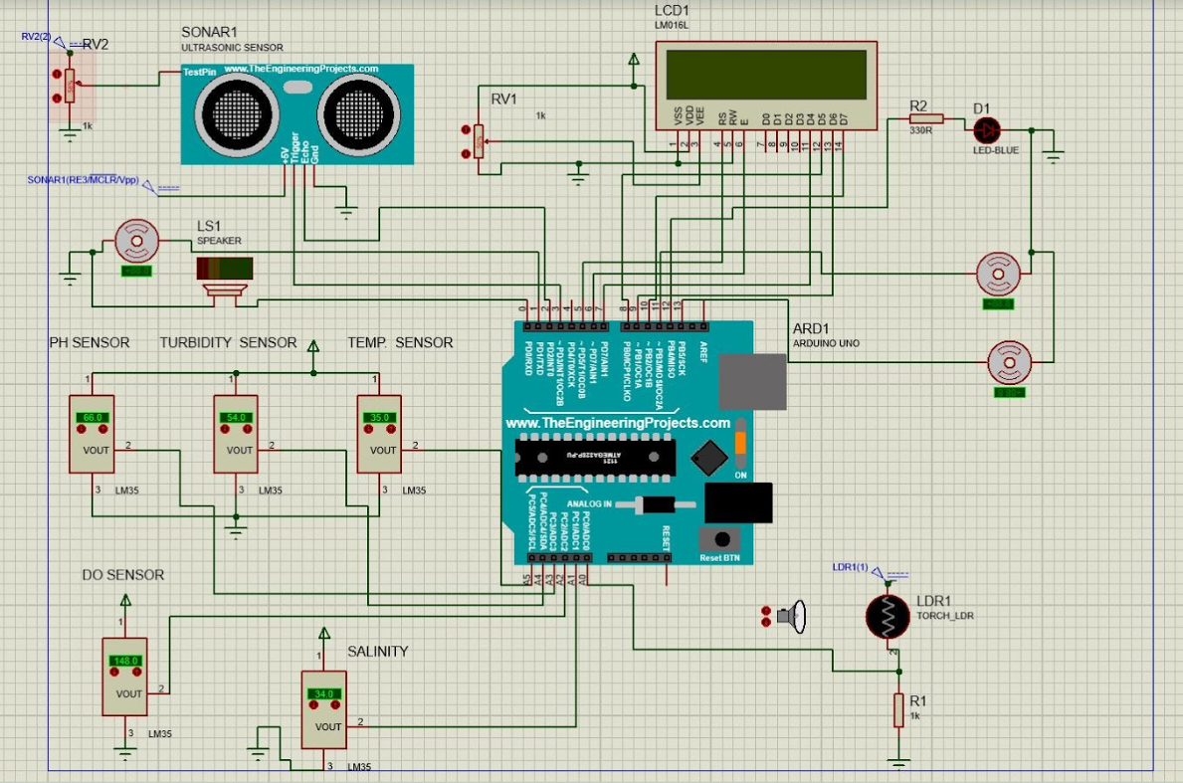
Automated Shrimp Farm Prototype

Slide 8
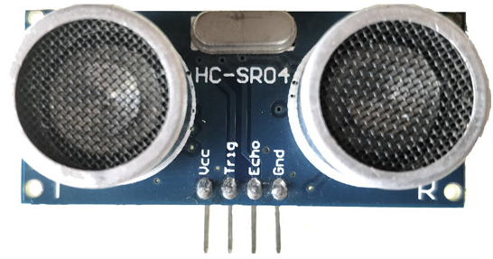
Ultrasonic sensor
We use this sensor to check the depth of the water level. If the water level is below than the usual a DC motor will run to rise the water level. It will continue until the tank fills in.
Makes water changing automated.

Slide 9
Automated Shrimp Farm Prototype

Slide 10
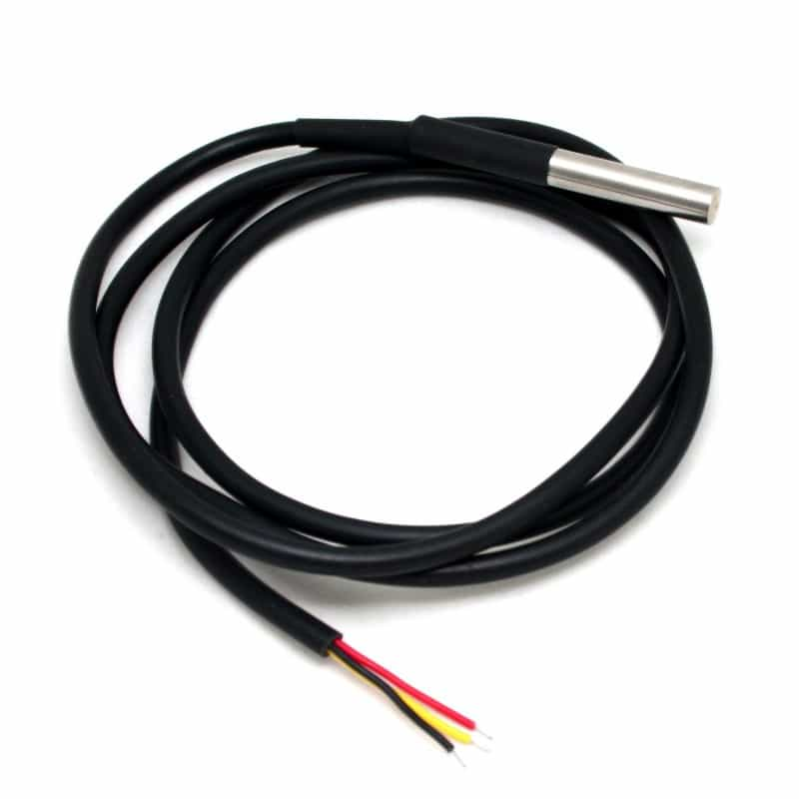
Waterproof Temperature Sensor
In our developed system, we use DS18B20 Waterproof Temperature Sensor to monitor the water temperature. By monitoring water temperature, the farmer can take the necessary steps. The LCD display shows the temperature of the water.

Slide 11
Automated Shrimp Farm Prototype

Slide 12
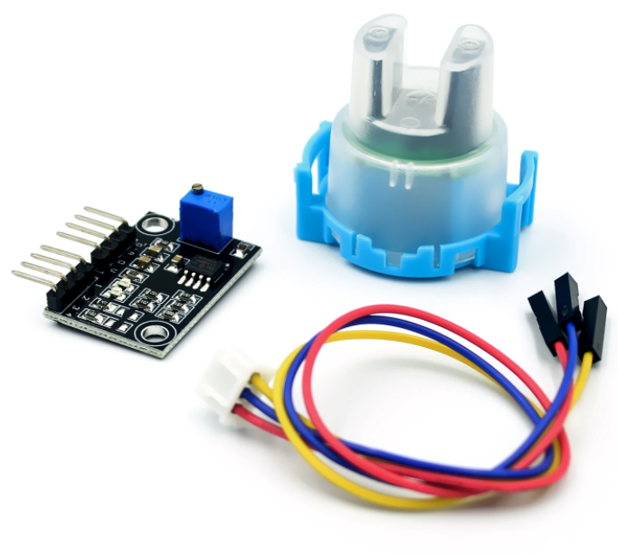
Turbidity Sensor
Water clarity checking using this sensor.
The ideal value of turbidity sensor for shrimp farming 6.28-16.51.
If the value is not between the ideal value a motor will on and the water will change until the value comes between the ideal value.

Slide 13
Automated Shrimp Farm Prototype

Slide 14
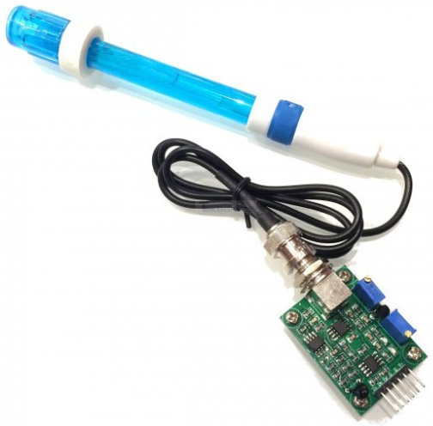
pH Sensor
We use this sensor to check if the water is salty or acidic.
The ideal pH level is 5 – 8. if pH level is not in between the ideal level a buzzer will give alert to change the water immediately.

Slide 15
Automated Shrimp Farm Prototype

Slide 16
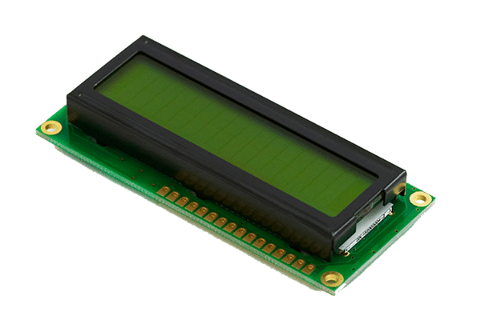
LCD Display 16/2
Using this we can see the water level, pH level, turbidity value, salinity level, DO count & temperature.

Slide 17
Automated Shrimp Farm Prototype
z

